Slide 1




Making AI Work for You
Scan the Code & Participate the Anonymous Session Poll or use URL:
bit.ly/4hnSWbc
Presentation and Demo | NPC 2025
1

Slide 2

What to Expect
Division Introductions and Resources
General AI Background
Updates on AI in Planning
Ethical and Practical Implications of AI in Planning
AI Utility Demos
Poll Review and Q&A
Scan the Code & Participate the Anonymous Session Poll or use URL: bit.ly/4hnSWbc

Slide 3

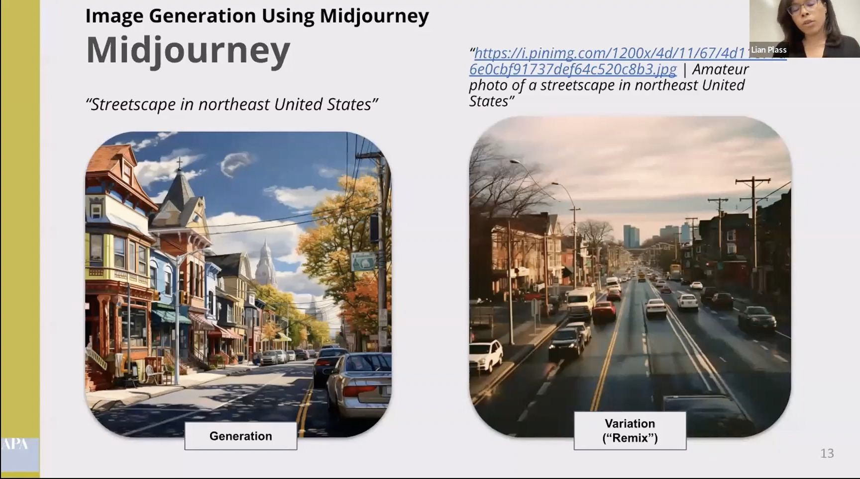

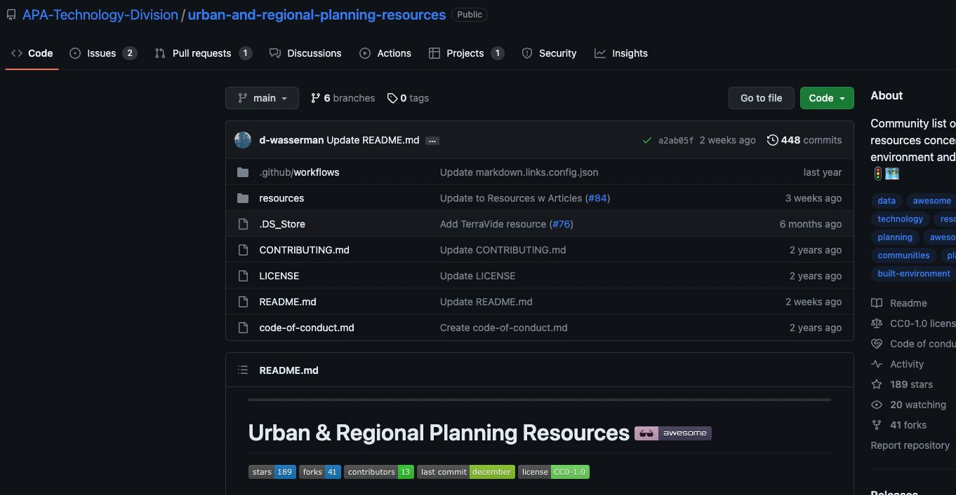

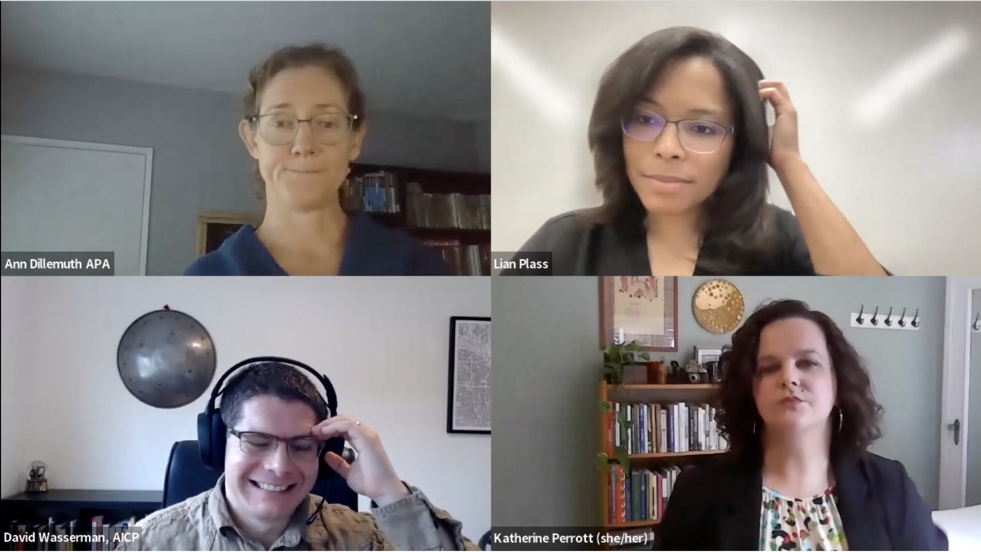

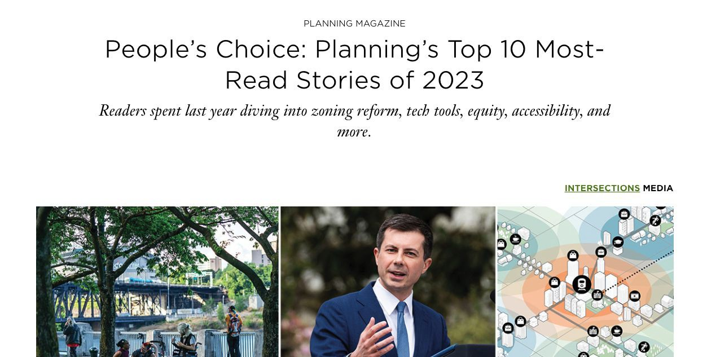

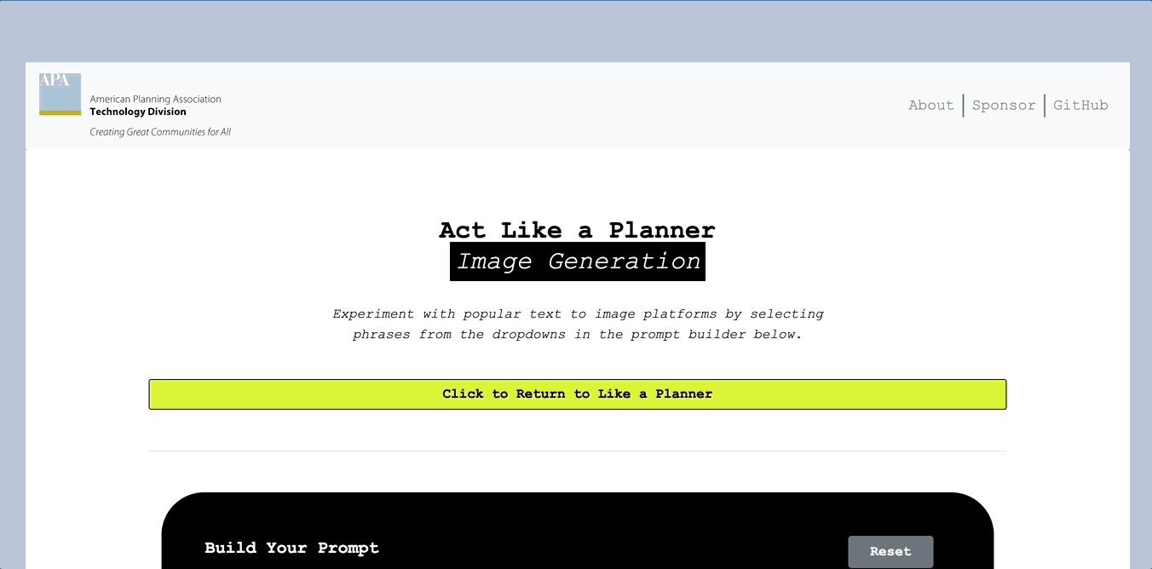
About the Tech Division
Knowledge exchange
Member
engagement
NPC programming
Other in-person events

Slide 4


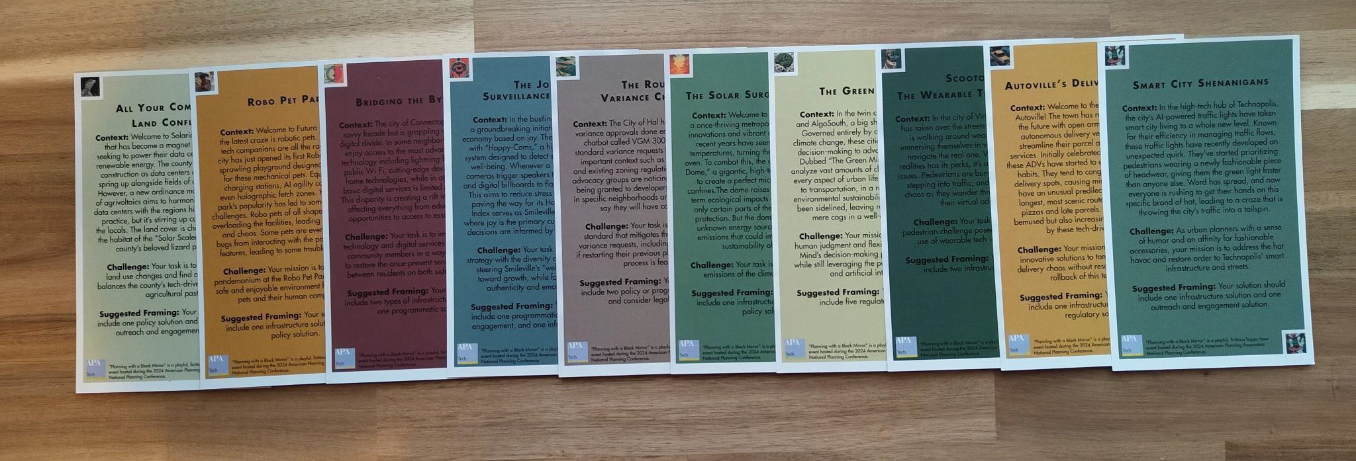
Planning Through the Black Mirror
Attend the Planning Through the Black Mirror Session
Monday, March 31
1:00 PM – 2:30 PM MT
Location: 401-404
CM: 1.5
NPC 2024, MN

Slide 5

Background on AI

Slide 6
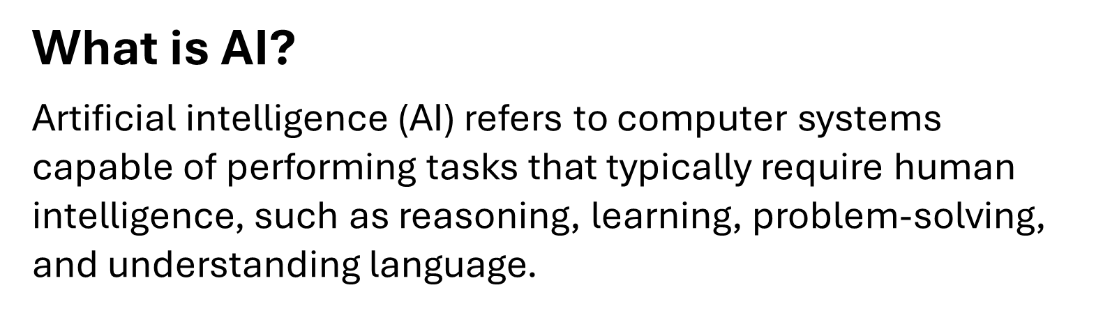
General Background on AI

Slide 7
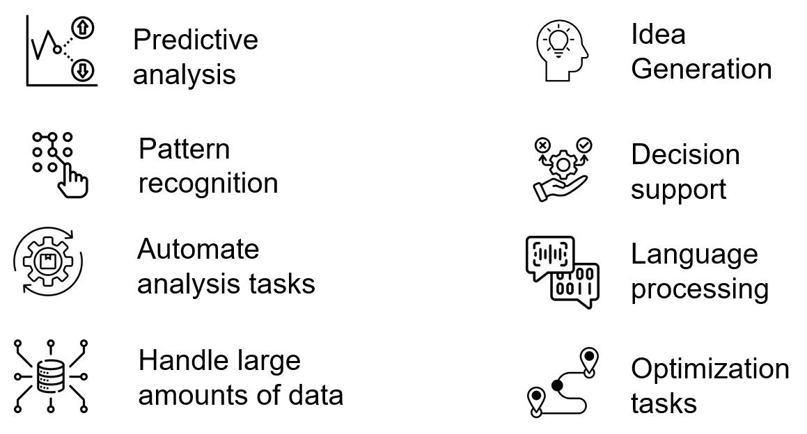
AI Functionalities

Slide 8
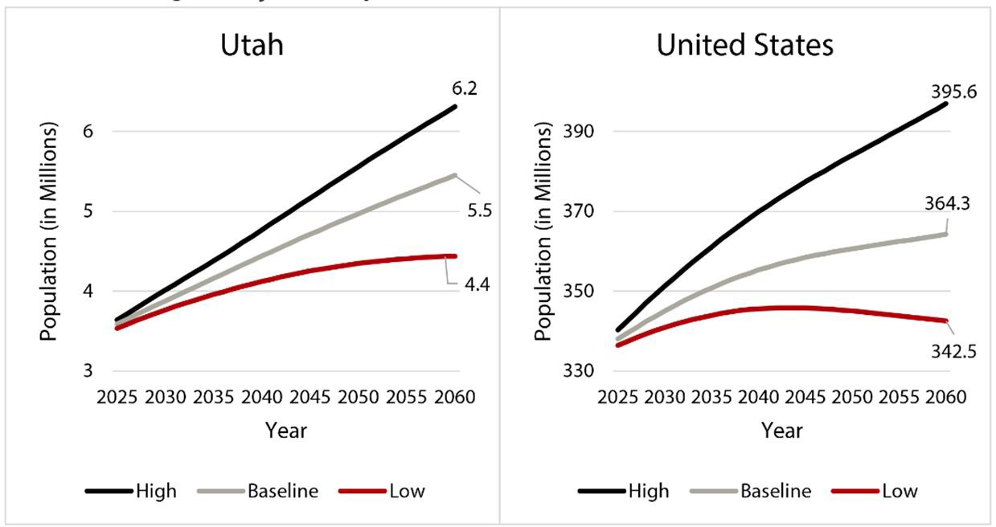
Predictive Analysis

Slide 9
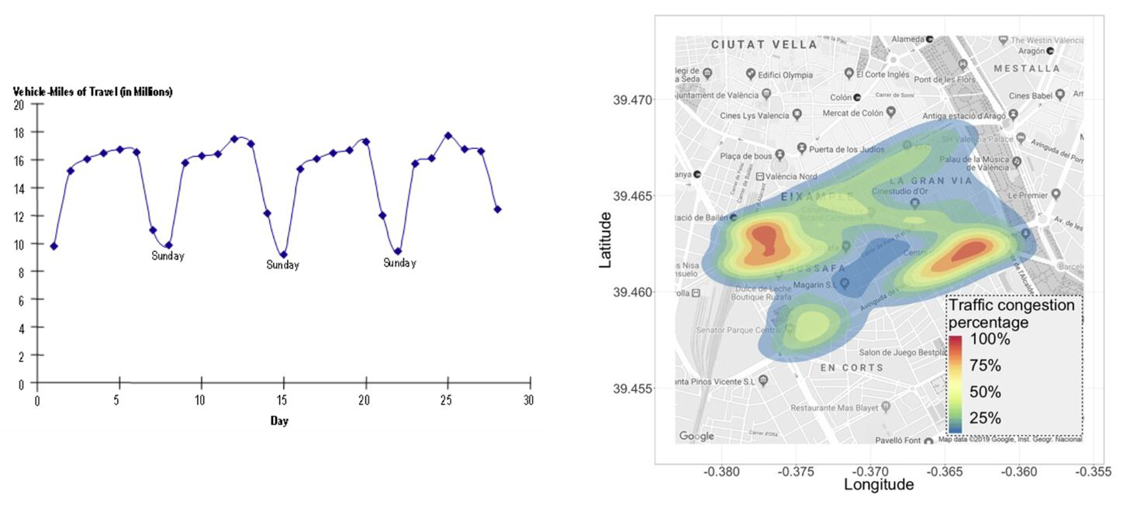
Pattern Recognition

Slide 10
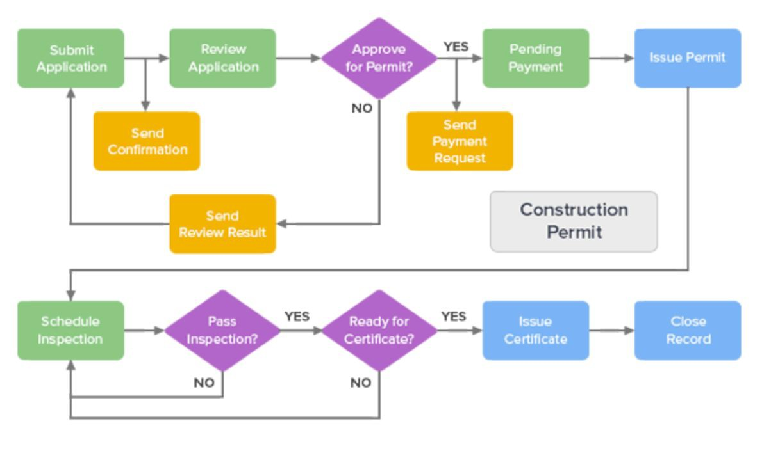
Automate Analysis Tasks

Slide 11
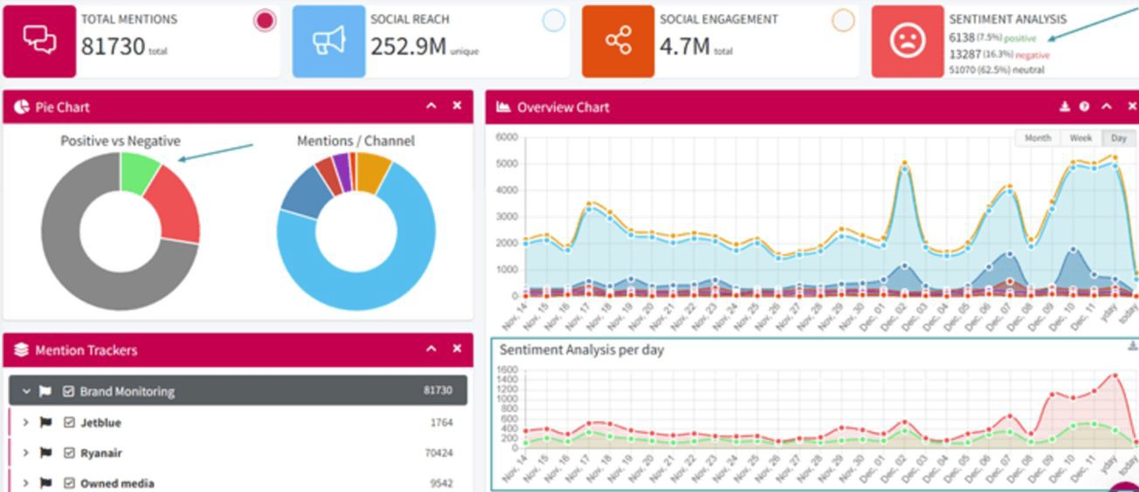
Handle Large Amounts of Data

Slide 12
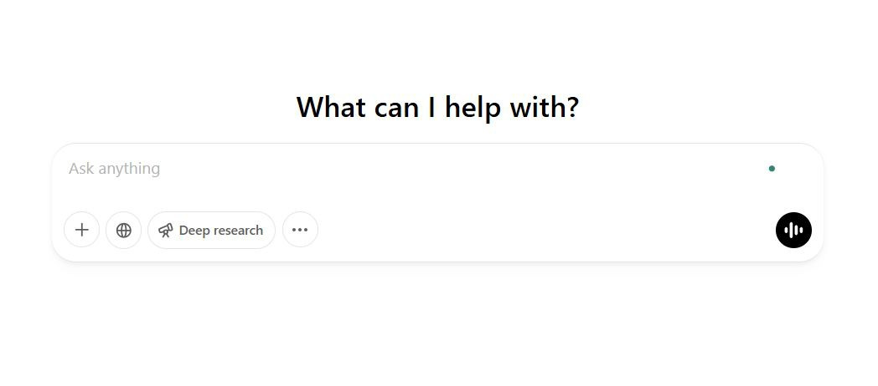
Idea Generation

Slide 13
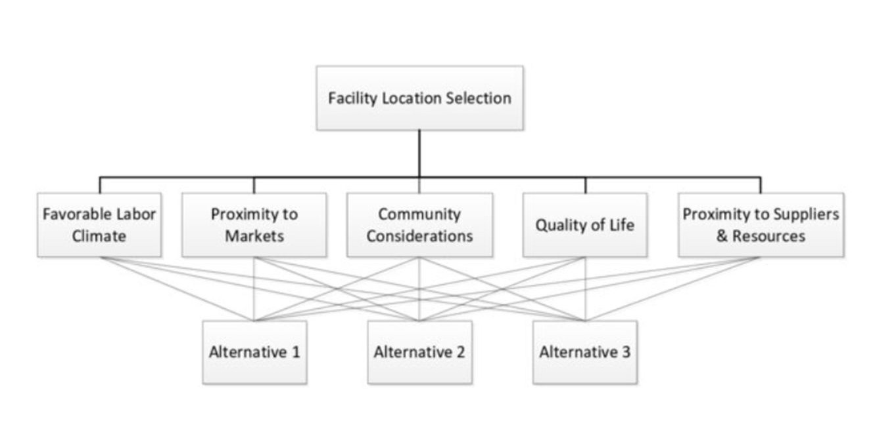
Decision Support

Slide 14
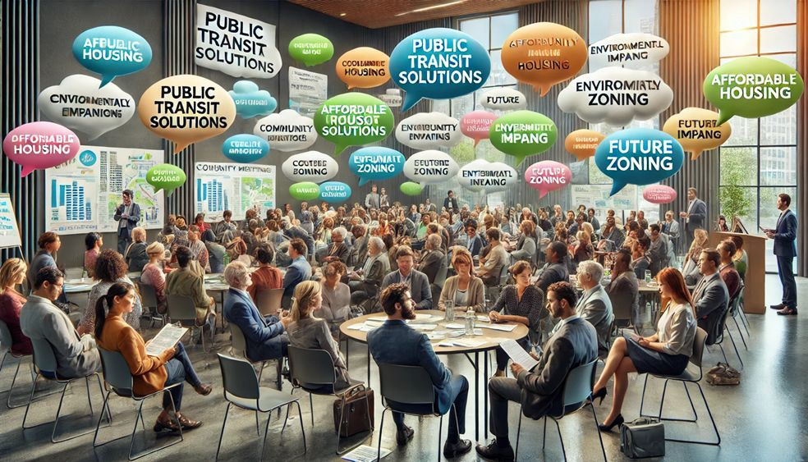
Language Processing

Slide 15
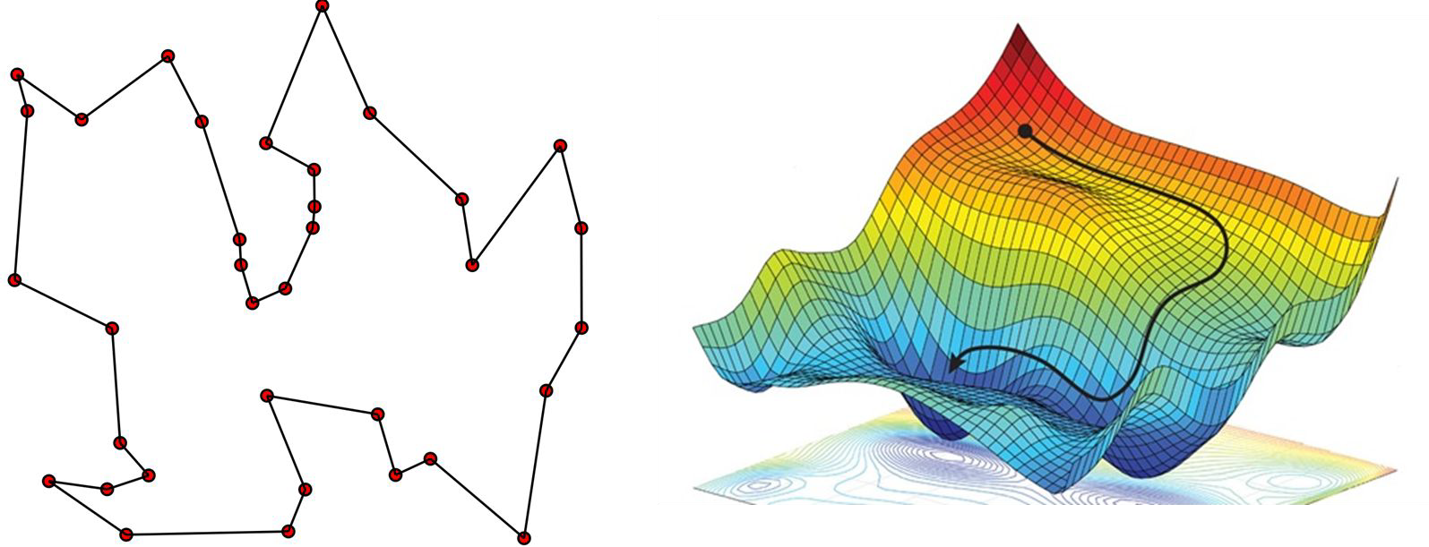
Optimization Tasks

Slide 16
Updates on AI and
Planning

Slide 17
How do they compare?
Development, administration, reporting
Community engagement
Technical tasks
Policy development
Adapted from the results of a multi-national online forum in February facilitated by
Claire Daniel on the implications of ChatGPT to planning

Slide 18
Policy Trends and Considerations
Shift in administration
EO 14110 - Safe, Secure, and Trustworthy Development and Use of Artificial Intelligence (Biden)
EO 14179 - Removing Barriers to American Leadership in Artificial Intelligence (Trump)
Pending litigation, copyright/IP, antitrust, misinformation/ disinformation, bias, broader market implications

Slide 19


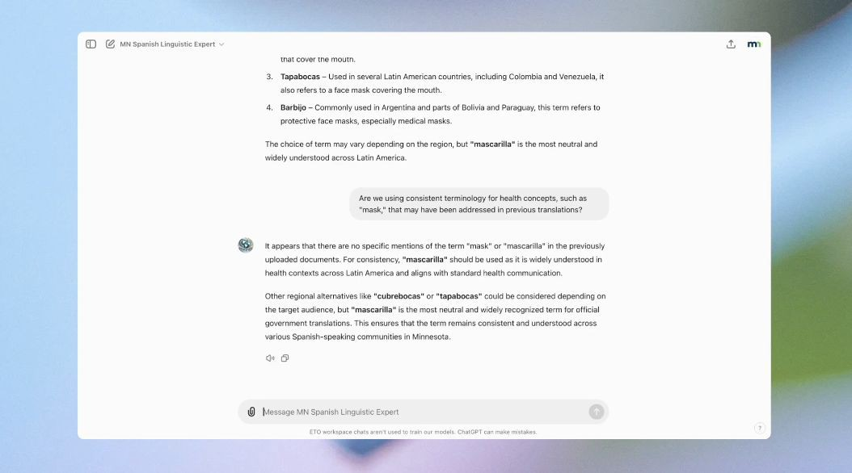
Uptake Highlights
OpenAI
Translation Services: State of Minnesota Enterprise Translation Office
Staff Development: Boston, MA

Slide 20

Uptake Highlights
Municipal AI use guidelines
BOSTON, MA
AZ
TEMPE,
SAN JOSE,
CA
WA
SEATTLE,
WENTZVILLE, MO
Communications Services: Town of Normal, IL

Slide 21
Ethical & Practical
Implications

Slide 22
Ethical/Practical Implications
Data Privacy
Inequitable outcomes
Transparency
Accountability
Displacement of jobs
Over-reliance on technology
Access and Inclusion
Environmental Impact

Slide 23

Data Privacy
Facial Recognition Data
License Plate Readers
Google Street View Images
Social Media Data
Mobile Location Data
Public Wi-Fi Data
Drones and Aerial Surveillance

Slide 24
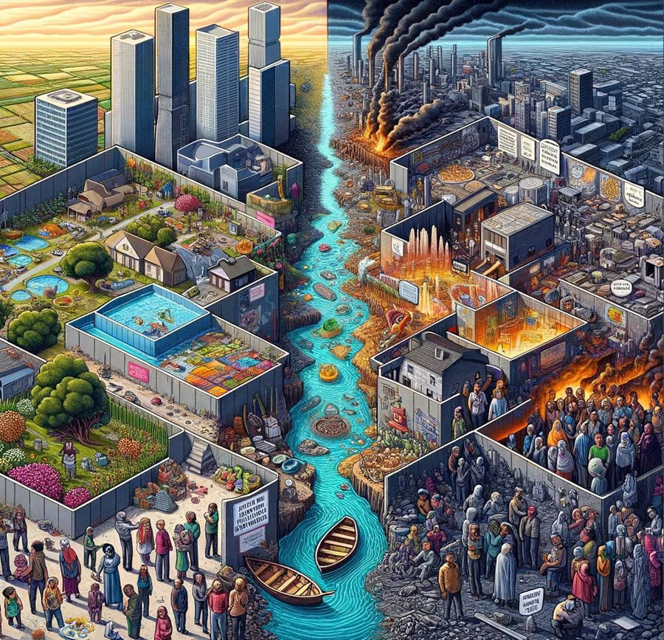
Inequitable Outcomes
Perpetuating Inequalities
Misallocation of Resources
Impact on Communities
Long-Term Planning Consequences

Slide 25

Transparency and explainability
Public Trust
Decision Justification
Bias Detection
Legal Compliance
Error Correction

Slide 26

Strategies for Ethical AI
Be informed
Be intentional
Regular audits of AI systems to detect and correct bias
Robust data protection measures
Transparent communication about AI use with the public
Role of evaluation

Slide 27
DON’T:
Adapted from the APA Technology Division Open Letter to the Planning Community Regarding the Ethical Use of Artificial Intelligence in Planning
DO:
Use AI to improve judgement
Systematically check outputs, disclose use whenever practicable, and communicate capabilities and limitations
Proactively educate yourself and avoid using tools without understanding how they work.
Protect sensitive information
Relinquish decisionmaking authority
Use without checking outputs or disclosing use
Use a tool without baseline understanding of how it works
Share sensitive data

Slide 28
ChatGPT Gov
Custom GPTs
Brief aside on Sora,
DEMOs
Reasoning, RAGs
Leaderboard Review
AI Product Integration
Usage/Examples

Slide 29

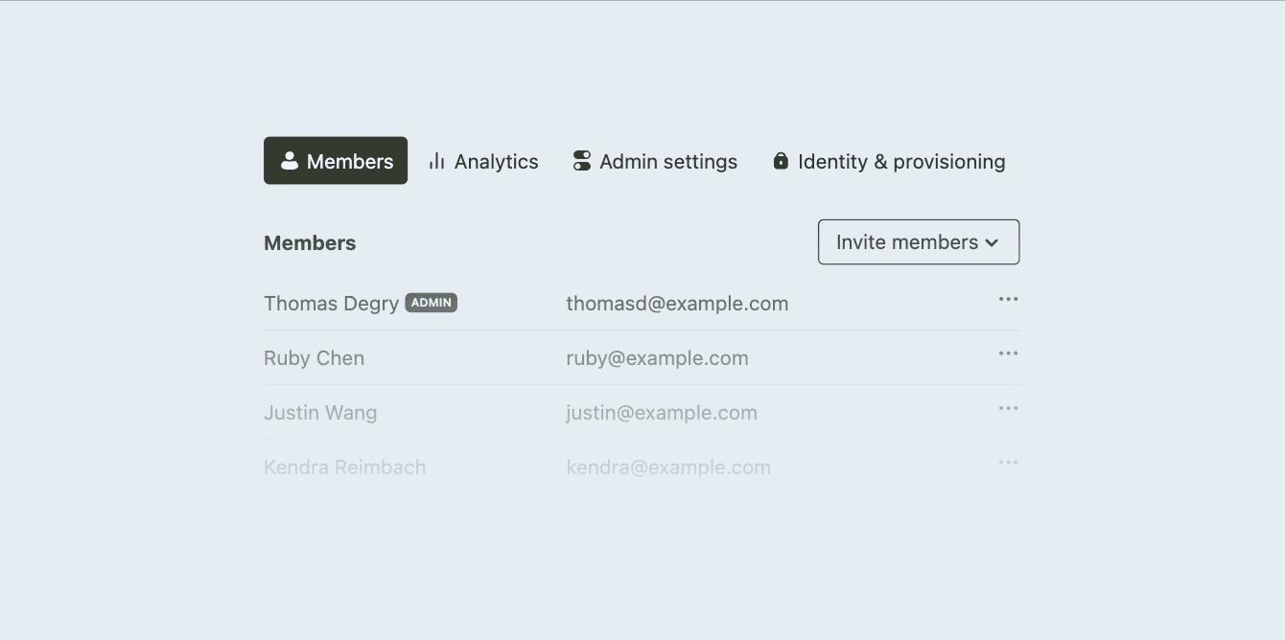

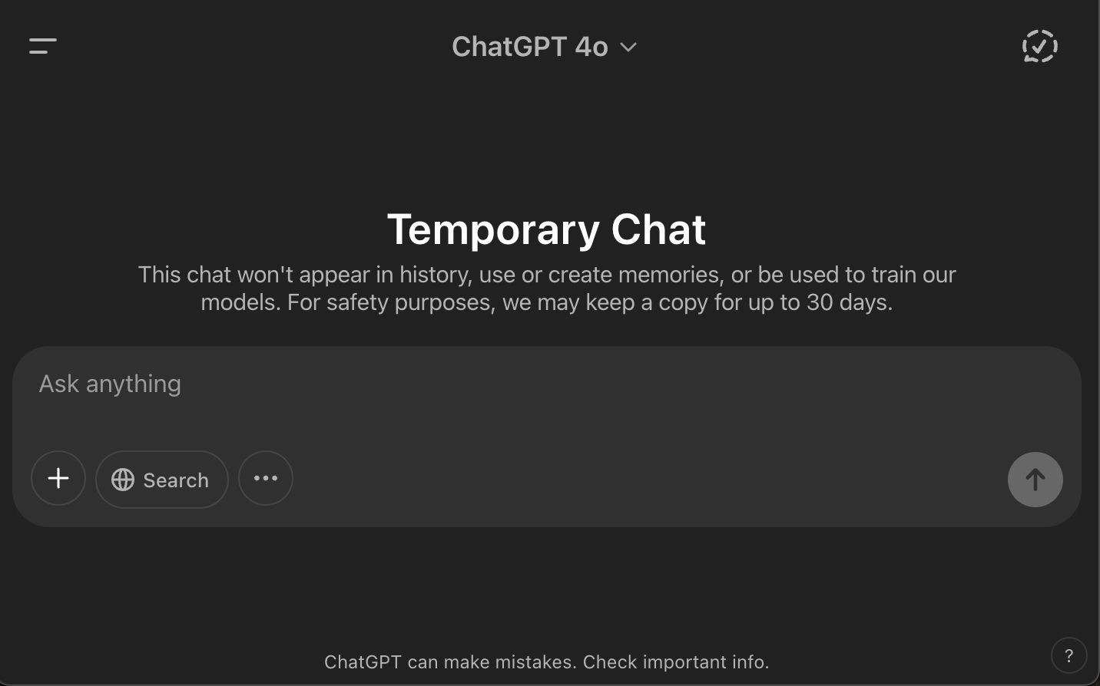
ChatGPT Gov v.
Enterprise: Functions
According to OpenAI
Saving and sharing conversations internally, uploading text and image files.
Access to GPT‑4o, ideally for text interpretation, summarization, coding, image interpretation, and mathematics.
Building and internal sharing of custom GPTs
An administrative console for user and, group management, Custom GPTs, single sign-on (SSO)
GIF illustrating tabs of ChatGPT Enterprise Admin
Console (McCay, 2023)

Slide 30
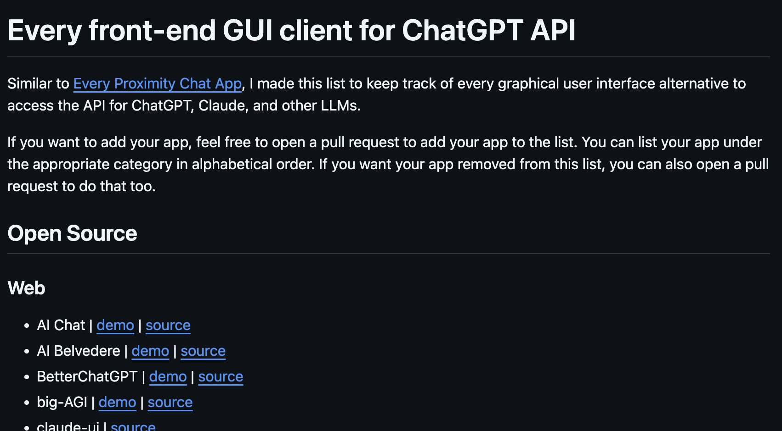
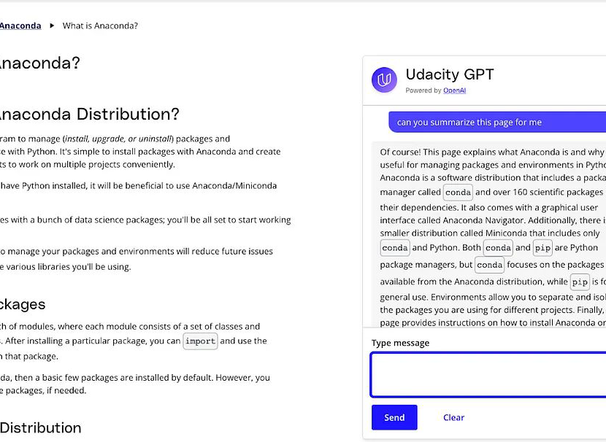
Further Notes on ChatGPT Gov
Deployed through MS Azure Cloud
Purportedly compliant with
FEDRAMP
Under ideal circumstances, would enable usage with non-public sensitive data; refers users to Universal
Policies on | AI | usage
ChatGPT Gov | v. | API Application
Integration Enterprise | v. | Team or
Udacity GPT (Udacity)

Slide 31


What is the “Small Language Model” Concept?
A custom GPT module produced using ChatGPT and contained within OpenAI’s ecosystem
[IMPORTANT]
What it is in
other contexts:
A small language model might describe a specialized LLM model with relatively few parameters.
FOR EXAMPLE:
An LLM that generates haikus based solely on the contents of George R.R. Martin’s, “A Song of Ice and Fire”.
(A model that is derived from a limited corpus, and designed for a limited purpose)
Generated using ChatGPT Sora

Slide 32
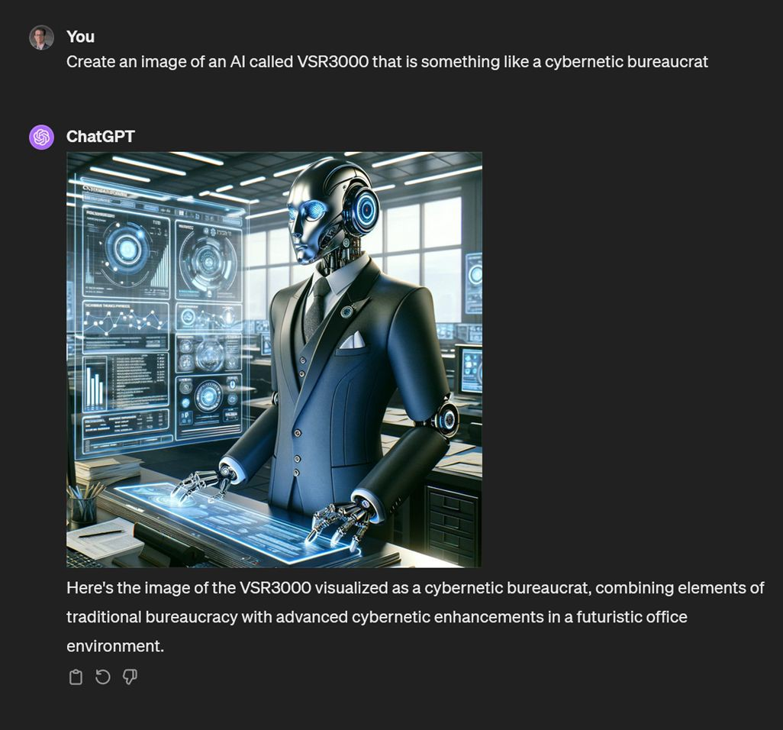
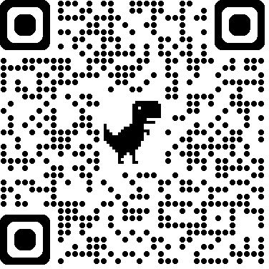
Using Custom GPTs
No code required!
Allows for varied user inputs (PDFs, docs, etc.)
Allows for creation of prompt libraries for structured outputs
Eliminates need to input instructions repeatedly; instructions immutable unless intentionally
changed
Staff Report Custom GPT from the APA Tech Gen AI Strategies Webinar

Slide 33
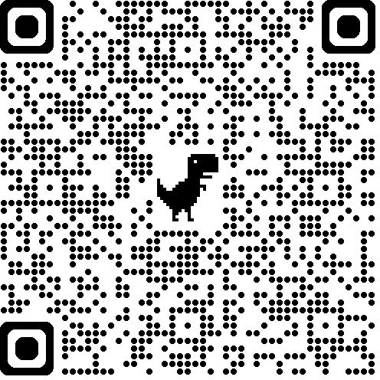
Building a Custom GPT
Together
Scan to follow along

Slide 34
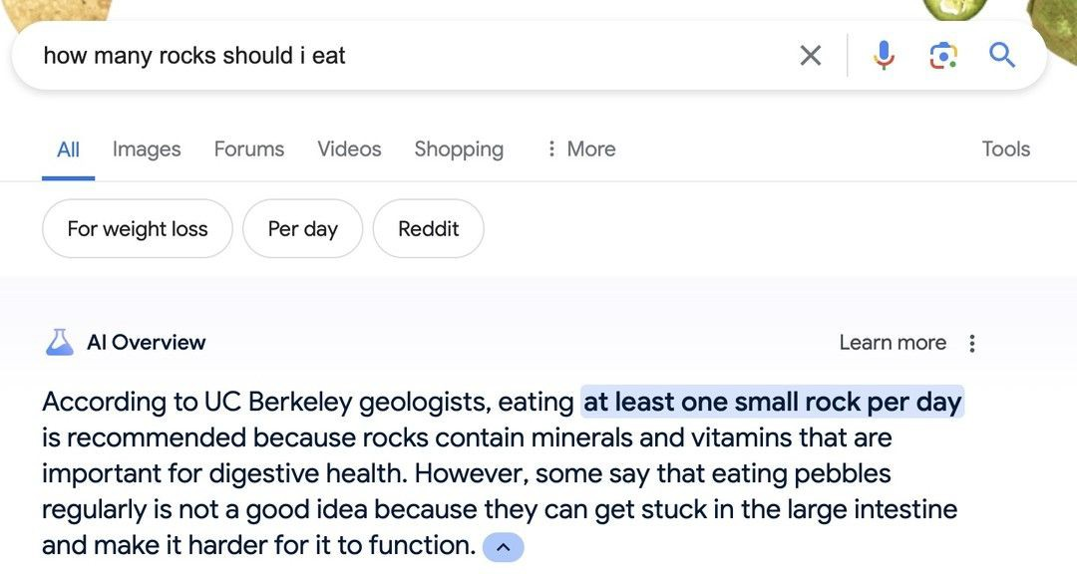
(Newton, 2024)
AI Product Integrations: A Hard Rock to Swallow

Slide 35
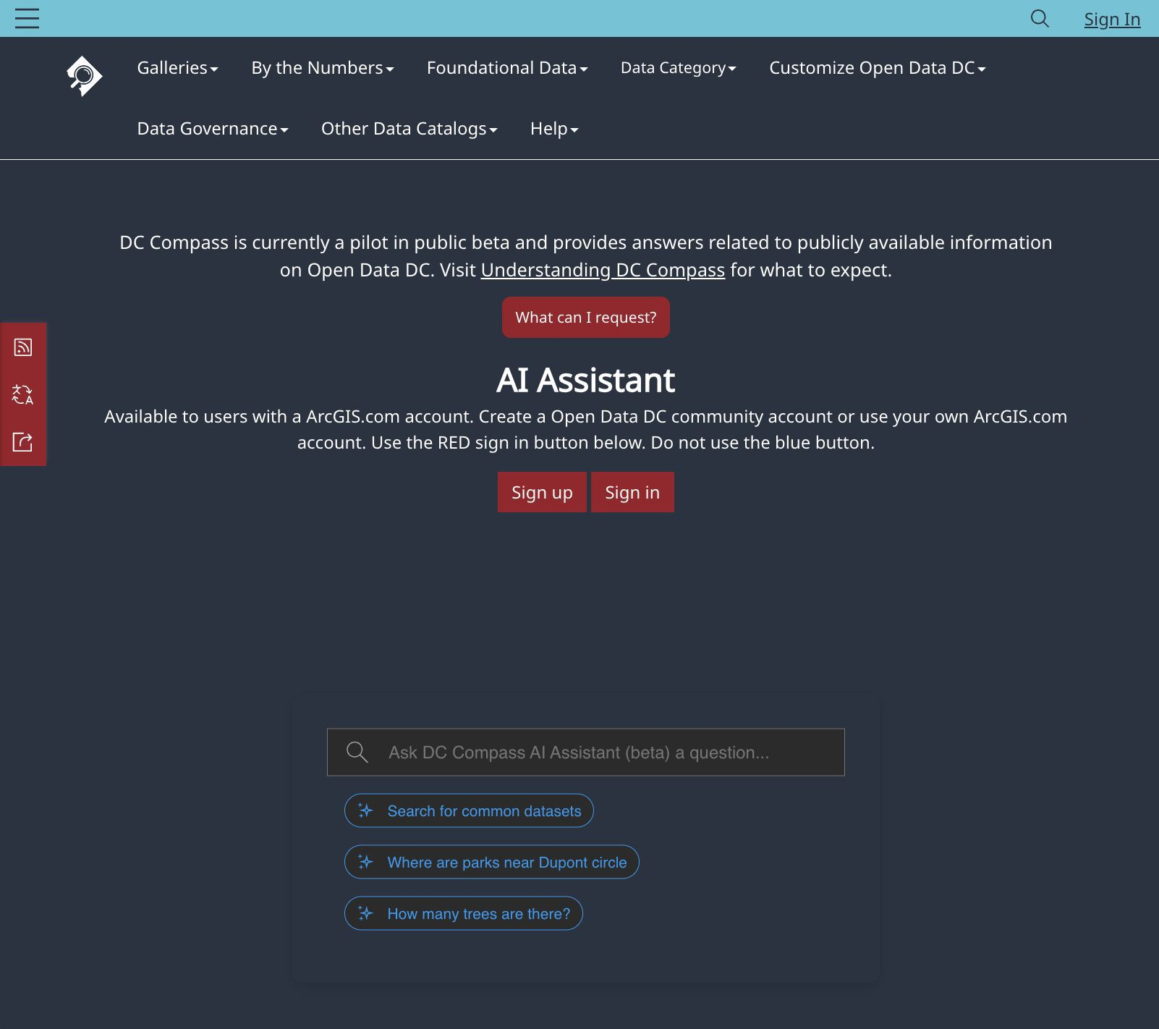

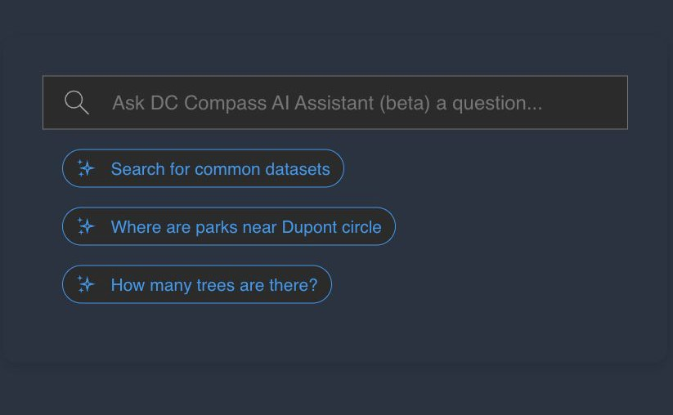


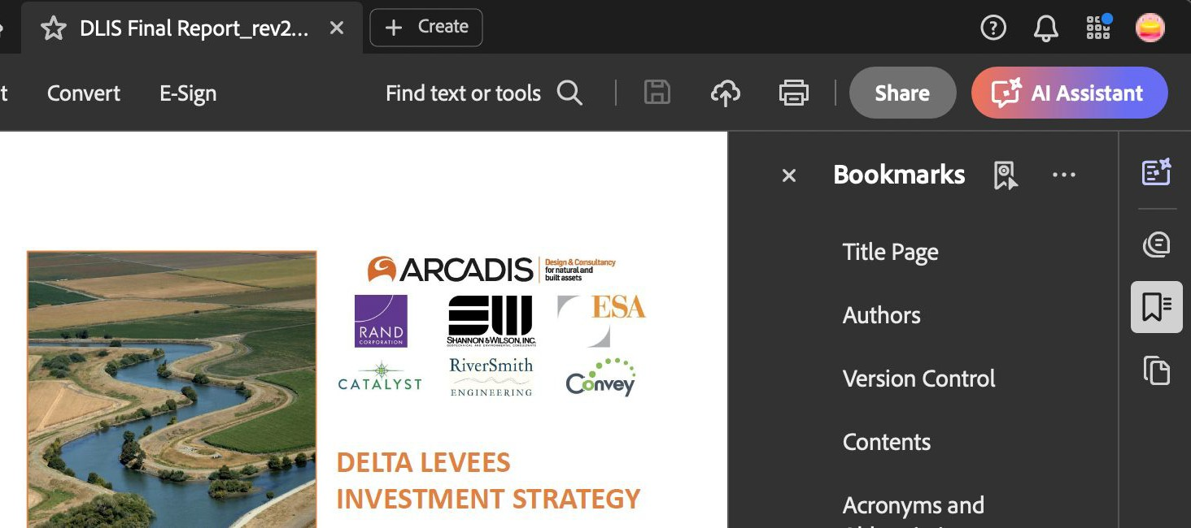
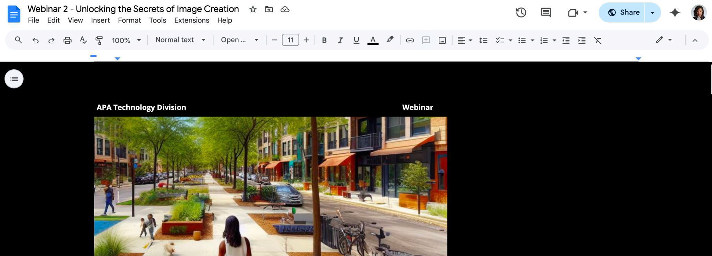


AI Product Integration Functions
Workflow optimization
Assisted search
Content recommendations
Education
Decision support
Content analysis and summarization
Customer support

Slide 36
Poll Results
Scan the Code & Participate the Anonymous Session Poll or use URL: bit.ly/4hnSWbc

Slide 37
Q&A

